Slide 1
26a – Clean Code – Design Patterns - Factories
Based on the CleanCoders videos by Uncle Bob Martin
Rupert Waldron

Slide 2
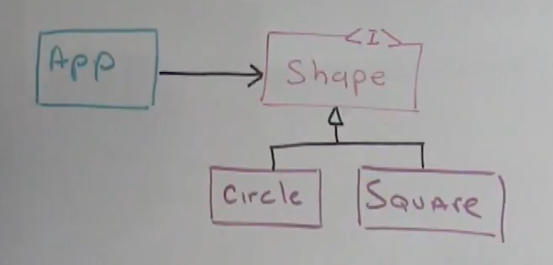
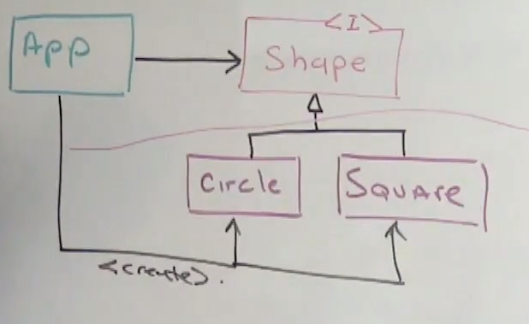
The Factory Pattern
Got an interface, were good to go!
App and Shape<I> can be shipped in a separate Jar to the shapes.
But wait how do we create the shapes…
We can use the magic of Spring to inject everything for us… Or

Slide 3
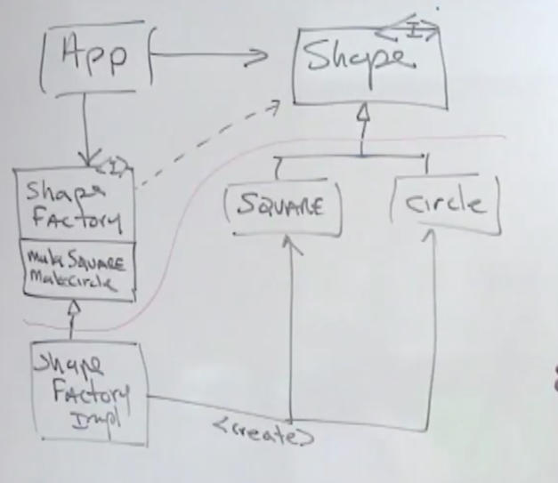

The Abstract Factory Pattern
Split the application like so
The classes above the line no nothing about the classes below the orange line…
We can package them into separate jars and ship them… and work on them separately. Lets have a look at the code.
We can use the magic of Spring to inject everything for us… Or

Slide 4
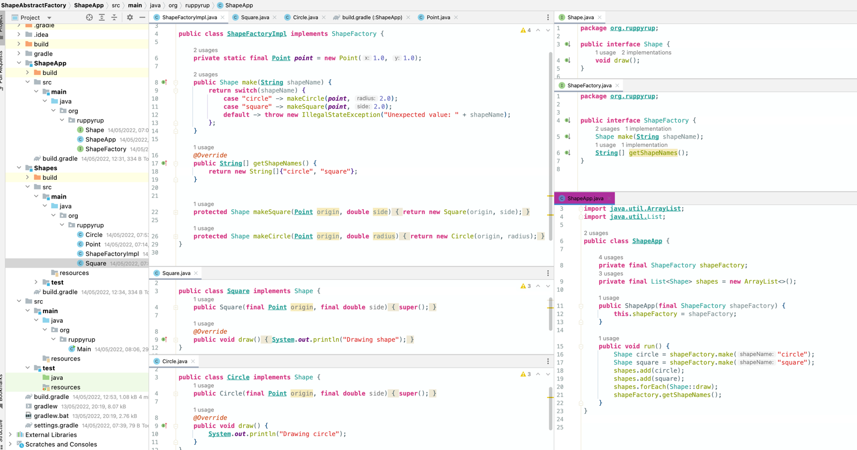

Slide 5
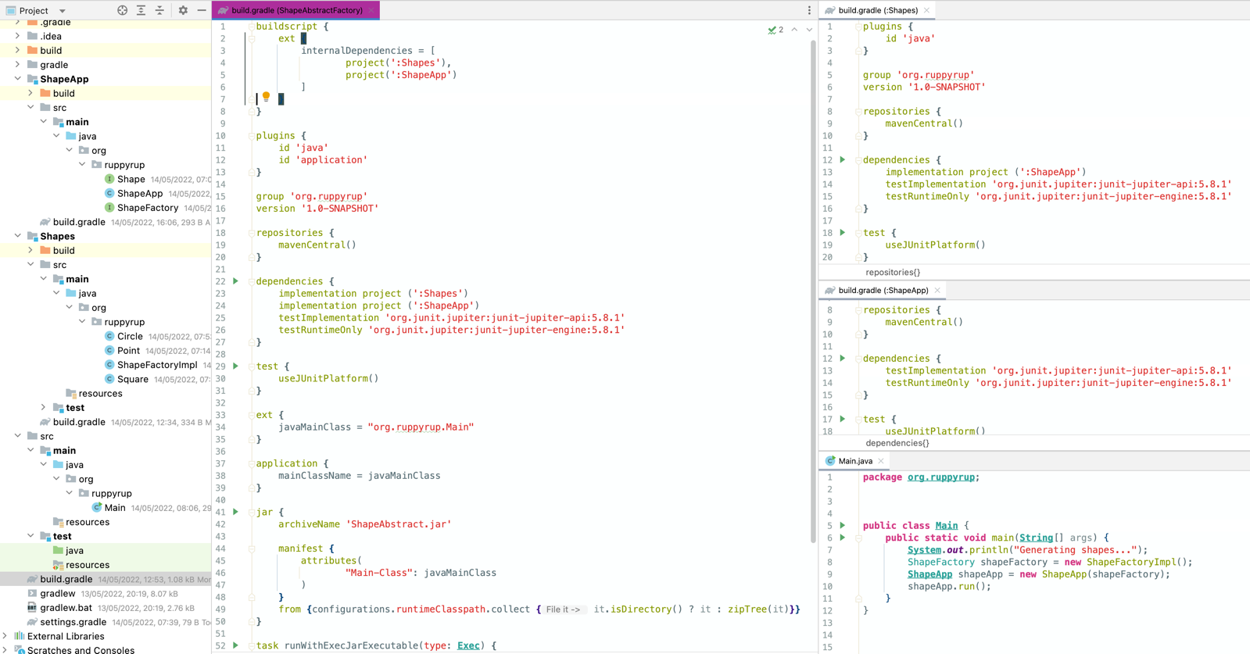
Shapes knows about ShapeApp
ShapeApp knows nothing about Shapes

Slide 6
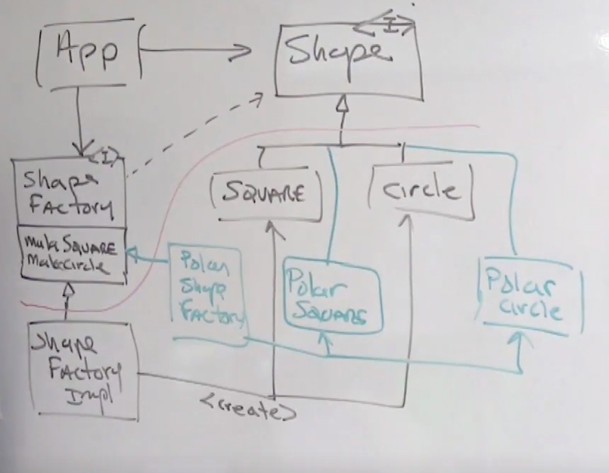
Adding another factory
There is no type safety as this relies on coupling.
An Enum would need to be declared below the red line because it is used by the shapeFactory, however, the shapeApp would need to specify the enum of the shape it wanted creating so the dependency go from ShapeApp to Shapes -> in the opposite direction.
Unit tests are the best way to check type safety.

Slide 7
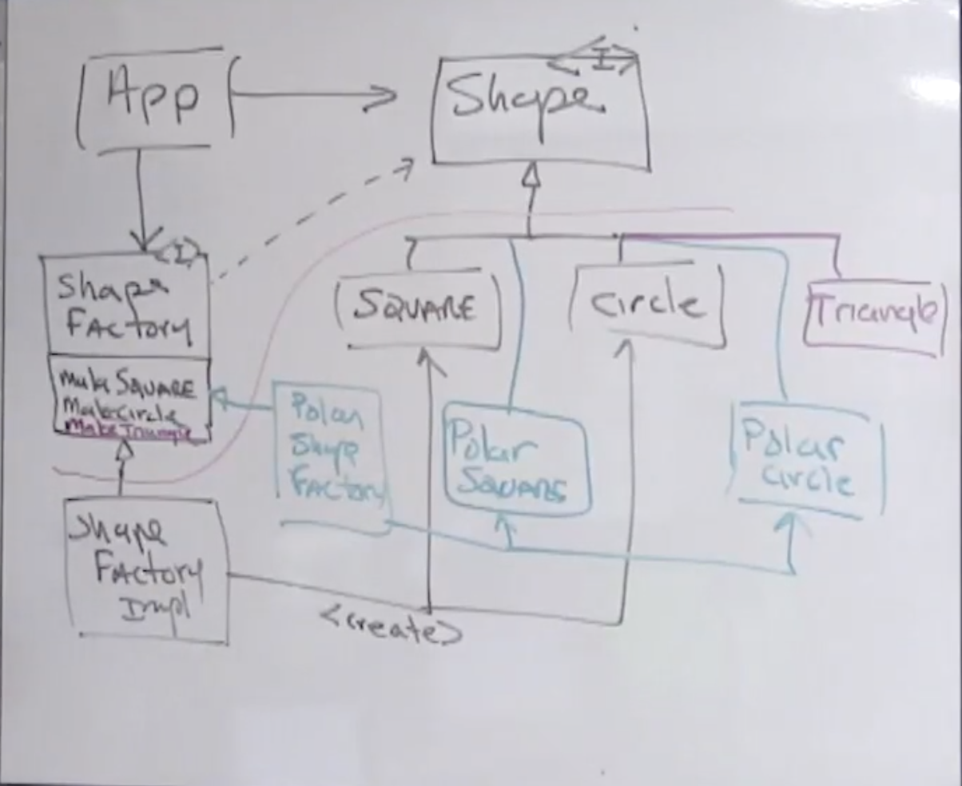
The boundary dilemma
The thing is, we have two make functions and two shapes, what happens when we need to add a triangle
The triangle is added below the line… but we then need to add the makeTriangle() above the red line. Doh!
There is a hidden dependency between the layers – the number of derivatives = the number of make methods.
We could just have a
make(ShapeType shapeType)
On the ShapeFactory interface. Da Dah!

Slide 8

The boundary dilemma cont…
The only problem with the Enum is it must be defined above the line and used below the line – coupling across the boundary. Every time a new derivative is added a new Enum must be added, so what do we do?
interface ShapeFactory { Shape make(String shapeName); }
We still need to know what shapeNames to use… unless we get the factory below to line to pass up all the shapes it can use!
interface ShapeFactory { Shape make(String shapeName); String[] getShapeNames(); }
So you’re right – it isn’t type safe, but all the type safe solutions interfere with independent deployability.

Slide 9
How to get around the type safety issue
Write some unit tests – they should pick up any type errors.

